Slide 1
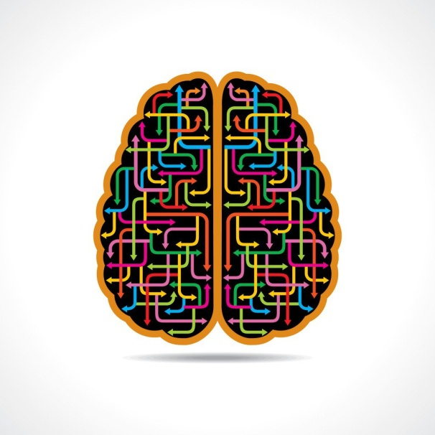
Grasha-Reichmann
Learning Style Scale
Chris deGraauw DC, FRCCSS(C)
Lara deGraauw DC, FRCCSS(C)

Slide 2
Learning styles was a popular topic in psychology through the 1960s and 1970s.
Scale developed in 1974 by Anthony Grasha and Sheryl Reichmann
60-point scale designed to identify 6 primary learning styles.

Slide 3
Focuses on the students attitudes toward their INTERACTION with their instructors, peers and learning itself, versus methods or achievement.
Grasha and Reichmann focused on communication in their work.
Can be paired with a TEACHING STYLES SURVEY.

Slide 4
The six learning styles are:
Avoidant,
Collaborative,
Competitive,
Dependent,
Independent,
Participant.

Slide 5
Avoidant
Unenthusiastic
Low active participation
Uninterested and Overwhelmed
Blanket grades

Slide 6
Collaborative
Sharing
Cooperation
Small groups
Student-designed
Group work

Slide 7
Competitive
Out-do
Rewards
Lead and dominate in discussions
Singled out

Slide 8
Dependant
Low curiosity
Bare bones
Need structure, instructions and authority
Teacher centered
Ambiguity challenges

Slide 9
Independant
Thinker
Confident
Independent study
Self paced instruction
Student-centered

Slide 10
Participant
Citizens
Responsibility
Take part
Discussion

Slide 12
References
Cassidy, S. 2004 Learning styles: An overview of theories, models, and measures, Educational Psychology,24(4), 419-444
http://www.ccsonline.ca/Resources/ideas/grasha-riechmann_learning_styles.pdf
http://home.earthlink.net/~davidpdiaz/LTS/sitepgs/grslss2.htm
http://waset.org/publications/6624/a-validity-and-reliability-study-of-grasha-riechmann-student-learning-style-scale
http://web.cortland.edu/andersmd/learning/Grasha.htm
http://academic.cuesta.edu/kbontenbal/dist101/lsurvey.htm
http://elearningindustry.com/learning-style-diagnostics-grasha-riechmann-student-learning-styles-scale

